Slide 1
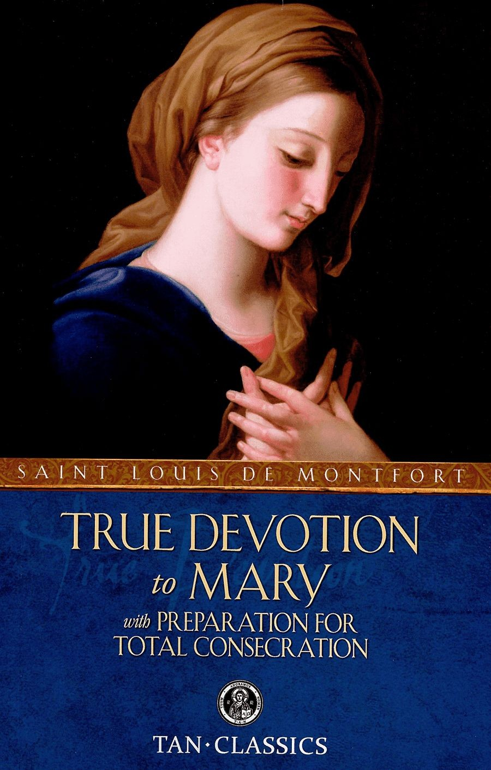
33 Day Preparation to the Total Act of Consecration to Jesus Through Mary
Prepared by Ando Perlas
Legion of Mary

Slide 2
DAILY PROGRAM OUTLINE
8:00 - Zoom Check In
8: 05 - Opening Prayer to the Blessed Virgin
8: 10 - Excerpt from True Devotion to Mary by Saint Louis Marie de Montfort
8: 20 - Daily Preparation - Prayers, Spiritual Reading and Reflections
8: 45 - Concluding Prayers

Slide 3
Day 1
Opening Prayer to the Blessed Virgin Mary
Memorare
Remember, O most gracious Virgin Mary, that never was it known that anyone who fled to thy protection, implored thy help, or sought thine intercession was left unaided.
Inspired by this confidence, I fly unto thee, O Virgin of virgins, my mother; to thee do I come, before thee I stand, sinful and sorrowful. O Mother of the Word Incarnate, despise not my petitions, but in thy mercy hear and answer me.
Amen.

Slide 4
Day 1 (Preliminary Remarks)
Excerpt from True Devotion to Mary
IT IS by the most holy Virgin Mary that Jesus has come into the world, and it is also by her that He has to reign in the world.
Mary has been singularly hidden during her life. It is on this account that the Holy Ghost and the Church call her alma Mater—Mother secret and hidden. Her humility was so profound that she had no propensity on earth more powerful or more unintermitting than that of hiding herself, even from herself, as well as from every other creature, so as to be known to God only.
He heard her prayers to Him, when she begged to be hidden, to be humbled, and to be treated as in all respects poor and of no account. He took pleasure in hiding her from all human creatures in her conception, in her birth, in her life, and in her resurrection and assumption. Her parents even did not know her, and the Angels often asked of each other: Quce est ista? Who is that? Because the Most High either hid her from them, or if He revealed anything of her to them, it was nothing compared to what He kept undisclosed.

Slide 5
Day 1 (Preliminary Remarks)
Excerpt from True Devotion to Mary
God the Father consented that she should do no miracle, at least no public one, during her life, although He had given her the power. God the Son consented that she should hardly ever speak, though He had communicated His wisdom to her. God the Holy Ghost, though she was His faithful Spouse, consented that His Apostles and Evangelists should speak but very little of her, and no more than was necessary to make Jesus Christ known.
Mary is the excellent masterpiece of the Most High, of which He has reserved to Himself both the knowledge and the possession. Mary is the admirable Mother of the Son, who took pleasure in humbling and concealing her during her life, in order to favour her humility, calling her by the name of woman (mulier), as if she was a stranger, although in His heart He esteemed and loved her above all angels and all men. Mary is the sealed fountain and the faithful Spouse of the Holy Ghost, to whom He alone has entrance. Mary is the sanctuary and the repose of the Holy Trinity, where God dwells more magnificently and more divinely than in any other place in the universe, without excepting His dwelling between the Cherubim and Seraphim. Neither is it allowed to any creature, no matter how pure, to enter into that sanctuary without a great and special privilege.

Slide 6
Day 1 (Preliminary Remarks)
Excerpt from True Devotion to Mary
I say with the Saints, The divine Mary is the terrestrial Paradise of the New Adam, where He is incarnate by the operation of the Holy Ghost, in order to work there incomprehensible marvels. She is the grand and divine World of God, where there are beauties and treasures unspeakable. She is the magnificence of the Most High, where He has hidden, as in her bosom, His only Son, and in Him all that is most excellent and most precious. Oh, what grand and hidden things that mighty God has wrought in this admirable creature! How has she herself been compelled to say it, in spite of her profound humility: Fecit mihi magna, qui potens est! The world knows them not, because it is at once incapable and unworthy of such knowledge.

Slide 7
Day 1 (Preliminary Remarks)
Excerpt from True Devotion to Mary
The Saints have said admirable things of this Holy City of God; and, as they themselves avow, they have never been more eloquent and more content than when they have spoken of her. Yet, after all they have said, they cry out that the height of her merits, which she has raised up to the throne of the Divinity, cannot be fully seen; that the breadth of her charity, which is broader than the earth, is in truth immeasurable; that the grandeur of her power, which she exercises even over God Himself, incomprehensible; and finally, that the depth of her humility, and of all her virtues and graces, is an abyss which never can be sounded. O height incomprehensible! O breadth unspeakable! O grandeur immeasurable! O abyss impenetrable!

Slide 8
Day 1 (Preliminary Remarks)
Excerpt from True Devotion to Mary
Every day, from one end of the earth to the other, in the highest heights of the heavens and in the profoundest depths of the abysses, everything preaches, everything publishes, the admirable Mary! The nine choirs of Angels, men of all ages, sexes, conditions, and religions, good or bad, nay even the devils themselves, willingly or unwillingly, are compelled, by the force of truth, to call her Blessed. St. Bonaventure tells us that all the Angels in heaven cry out incessantly to her, Sancta, sancta, sancta Maria, Dei Genitrix et Virgo; and that they offer to her millions and millions of times a day the Angelical Salutation, Ave Maria; prostrating themselves before her, and begging of her, in her graciousness, to honour them with some of her commands. St. Michael, as St. Augustine says, although the prince of all the heavenly court, is the most zealous in honouring her and causing her to be honoured, while he waits always in expectation that he may have the honour to go, at her bidding, to render service to some one of her servants.

Slide 9
Day 1 (Preliminary Remarks)
Excerpt from True Devotion to Mary
The whole earth is full of her glory, especially among Christians, amongst whom she is taken as the protectress of many kingdoms, provinces, dioceses, and cities. Numbers of cathedrals are consecrated to God under her name. There is not a church without an altar in her honour, not a country or a canton where there are not some miraculous images, where all sorts of evils are cured, and all sorts of good gifts obtained. Who can count the confraternities and congregations in her honour? How many religious orders have been founded in her name and under her protection! What numbers there are of Brothers and Sisters of all these confraternities, and of religious men and women of all these orders, who publish her praises and confess her mercies! There is not a little child, who, as it lisps the Ave Maria, does not praise her. There is scarcely a sinner who, even in his obduracy, has not some spark of confidence in her. Nay the very devils in hell respect her while they fear her.

Slide 10
Day 1 (Preliminary Remarks)
Excerpt from True Devotion to Mary
After that we must surely say with the Saints, De Maria nunquam satis; we have not yet praised, exalted, honoured, loved, and served Mary as we ought to do. She has deserved still more praise, still more respect, still more love, and far more service.
After that we must say with the Holy Ghost, Omnis gloria filice Regis ab intus—“All the glory of the King’s daughter is within.” It is as if all the outward glory, which heaven and earth rival each other in laying at her feet, is nothing in comparison with that which she receives within from the Creator, and which is not known by creatures, who in their littleness are unable to penetrate the secret of the secrets of the King.
After that we must cry out with the Apostle, Nec oculus vidit, nec auris audivit, nec in cor hominis ascendit—“Eye has not seen, nor ear heard, nor man’s heart comprehended,” the beauties, the grandeurs, the excellences, of Mary, the miracle of the miracles of grace, of nature, and of glory. If you wish to comprehend the Mother, says a Saint, comprehend the Son; for she is the worthy Mother of God. Hic taceat omnis lingua, “Here let every tongue be mute.”

Slide 11
Day 1 (Preliminary Remarks)
Excerpt from True Devotion to Mary
It is with a particular joy that my heart has dictated what I have just written, in order to show that the divine Mary has been up to this time unknown, and that this is one of the reasons that Jesus Christ is not known as He ought to be. If, then, as is certain, the kingdom of Jesus Christ is to come into the world, it will be but a necessary consequence of the knowledge of the kingdom of the most holy Virgin Mary, who brought Him into the world the first time, and will make His second advent full of splendour.

Slide 12
Day 2 (Necessity of Mary and Devotion to Her)
Excerpt from True Devotion to Mary
38. Mary is the Queen of heaven and earth by grace, as Jesus is the King of them by nature and by conquest. Now, as the kingdom of Jesus Christ consists principally in the heart and interior of a man—according to that word, “The kingdom of God is within you,”—in like manner the kingdom of our Blessed Lady is principally in the interior of a man, that is to say, his soul; and it is principally in souls that she is more glorified with her Son than in all visible creatures, and that we can call her, as the Saints do, the Queen of hearts.

Slide 13
Day 2 (Necessity of Mary and Devotion to Her)
Excerpt from True Devotion to Mary
41 … Among all the passages of the holy Fathers and doctors, of which I have made an ample collection, in order to prove this truth, I shall, for brevity’s sake, quote but one: Tibi devotum esse, est arma qucedam salutis quce Deus his dat, quos vult salvos fieri—“To be devout to you, O holy Virgin,” says St. John Damascene, “is an arm of salvation which God gives to those whom He wishes to save.”

Slide 14
Day 2 (Necessity of Mary and Devotion to Her)
Excerpt from True Devotion to Mary
42 I could bring forward here many histories which prove the same thing, and, among others, one which is related in the chronicles of St. Dominic. There was an unhappy heretic near Carcassonne, where St. Dominic was preaching the Rosary, who was possessed by a legion of fifteen thousand devils. These evil spirits were compelled, to their confusion, by the commandment of our Blessed Lady, to avow many great and consoling truths, touching devotion to the holy Virgin; and they did this with so much force, and so much clearness, that it is not possible to read this authentic history, and the panegyric which the devil made, in spite of himself, of devotion to the most holy Mary, without shedding tears of joy, however lukewarm we may be in our devotion to her.

Slide 15
Day 2 (Necessity of Mary and Devotion to Her)
Excerpt from True Devotion to Mary
43 If devotion to the most holy Virgin Mary is necessary to all men, simply for working out their salvation, it is still more so for those who are called to any particular perfection; and I do not think anyone can acquire an intimate union with our Lord, and a perfect fidelity to the Holy Ghost, without a very great union with the most holy Virgin, and a great dependence on her succour.

Slide 16
Day 2 (Necessity of Mary and Devotion to Her)
Excerpt from True Devotion to Mary
45 It is Mary alone to whom God has given the keys of the cellars of divine love, and the power to enter into the most sublime and secret ways of perfection, and the power likewise to make others enter in there also. It is Mary alone who has given to the miserable children of Eve, the faithless, the entry into the terrestrial paradise, that they may walk there agreeably with God, hide themselves there securely against their enemies, and feed themselves there deliciously, without any more fear of death, on the fruit of the trees of life and of the knowledge of good and evil, and drink in long draughts the heavenly waters of that fair fountain, which gushes forth there with abundance;

Slide 17
Day 2 (Necessity of Mary and Devotion to Her)
50. God, then, wishes to reveal and discover Mary, the masterpiece of His hands, in these latter times:
§ 1. Because she hid herself in this world, and put herself lower than the dust by her profound humility, having obtained of God and of His Apostles and Evangelists that she should not be made manifest.
§ 2. Because, being the masterpiece of the hands of God, as well here below by grace as in heaven by glory, He wishes to be glorified and praised in her by those who are living upon the earth.
§ 3. As she is the aurora which precedes and discovers the Sun of Justice, who is Jesus Christ, she ought to be recognized and perceived, in order that Jesus Christ may be so.
§ 4. Being the way by which Jesus Christ came to us the first time, she will also be the way by which He will come the second time, though not in the same manner.

Slide 18
Day 2 (Necessity of Mary and Devotion to Her)
Excerpt from True Devotion to Mary
§ 5.Being the sure means and the straight and immaculate way to go to Jesus Christ, and to find Him perfectly, it is by her that the holy souls, who are to shine forth especially in sanctity, have to find our Lord. He who shall find Mary shall find life; that is, Jesus Christ, who is the Way, the Truth, and the Life. But no one can find Mary who does not seek her; and no one can seek her, who does not know her: for we cannot seek or desire an unknown object. It is necessary, then, for the greater knowledge and glory of the Most Holy Trinity, that Mary should be more known than ever.
§ 6. Mary must shine forth more than ever in mercy, in might, and in grace, in these latter times: in mercy, to bring back and lovingly receive the poor strayed sinners who shall be converted and shall return to the Catholic Church; in might, against the enemies of God, idolaters, schismatics, Mahometans, Jews, and souls hardened in impiety, who shall rise in terrible revolt against God to seduce all those who shall be contrary to them, and to make them fall by promises and threats; and, finally, she must shine forth in grace, in order to animate and sustain the valiant soldiers and faithful servants of Jesus Christ, who shall do battle for His interests.
Notes:
§ 7. And, lastly, Mary must be terrible to the devil and his crew, as an army ranged in battle, principally in these latter times, because the devil, knowing that he has but little time, and now less than ever, to destroy souls, will every day redouble his efforts and his combats. He will presently raise up new persecutions, and will put terrible snares before the faithful servants and true children of Mary, whom it gives him more trouble to surmount than it does to conquer others.

Slide 19
Day 2 (Necessity of Mary and Devotion to Her)
Excerpt from True Devotion to Mary
§ 5.Being the sure means and the straight and immaculate way to go to Jesus Christ, and to find Him perfectly, it is by her that the holy souls, who are to shine forth especially in sanctity, have to find our Lord. He who shall find Mary shall find life; that is, Jesus Christ, who is the Way, the Truth, and the Life. But no one can find Mary who does not seek her; and no one can seek her, who does not know her: for we cannot seek or desire an unknown object. It is necessary, then, for the greater knowledge and glory of the Most Holy Trinity, that Mary should be more known than ever.
§ 6. Mary must shine forth more than ever in mercy, in might, and in grace, in these latter times: in mercy, to bring back and lovingly receive the poor strayed sinners who shall be converted and shall return to the Catholic Church; in might, against the enemies of God, idolaters, schismatics, Mahometans, Jews, and souls hardened in impiety, who shall rise in terrible revolt against God to seduce all those who shall be contrary to them, and to make them fall by promises and threats; and, finally, she must shine forth in grace, in order to animate and sustain the valiant soldiers and faithful servants of Jesus Christ, who shall do battle for His interests.
Notes:
§ 7. And, lastly, Mary must be terrible to the devil and his crew, as an army ranged in battle, principally in these latter times, because the devil, knowing that he has but little time, and now less than ever, to destroy souls, will every day redouble his efforts and his combats. He will presently raise up new persecutions, and will put terrible snares before the faithful servants and true children of Mary, whom it gives him more trouble to surmount than it does to conquer others.

Slide 20
Day 2 (Necessity of Mary and Devotion to Her)
Excerpt from True Devotion to Mary
55. In a word, God wishes that His holy Mother should be at present more known, more loved, more honoured, than she has ever been. This no doubt will take place, if the predestinate enter, with the grace and light of the Holy Ghost, into the interior and perfect practice which I will disclose to them shortly. Then they will see clearly, as far as faith allows, that beautiful Star of the Sea. They will arrive happily in harbour, following its guidance, in spite of the tempests and the pirates. They will know the grandeurs of that Queen, and will consecrate themselves entirely to her service, as subjects and slaves of love. They will experience her sweetnesses and her maternal goodnesses, and they will love her tenderly like well-beloved children. They will know the mercies of which she is full, and the need they have of her succour; and they will have recourse to her in all things, as to their dear advocate and mediatrix with Jesus Christ. They will know what is the most sure, the most easy, the most short, and the most perfect means by which to go to Jesus Christ; and they will deliver themselves to Mary, body and soul, without reserve, that they may thus be all for Jesus Christ.
Notes:
§ 7. And, lastly, Mary must be terrible to the devil and his crew, as an army ranged in battle, principally in these latter times, because the devil, knowing that he has but little time, and now less than ever, to destroy souls, will every day redouble his efforts and his combats. He will presently raise up new persecutions, and will put terrible snares before the faithful servants and true children of Mary, whom it gives him more trouble to surmount than it does to conquer others.

Slide 21
Day 1 Preparation
Renunciation of the World
Veni Creator
Come, O Creator Spirit blest! And in our souls take up Thy rest; Come with Thy grace and heavenly aid, To fill the hearts which Thou hast made. Great Paraclete! To Thee we cry, O highest gift of God most high! O font of life! O fire of love! And sweet anointing from above.
Thou in Thy sevenfold gifts art known, The finger of God's hand we own; The promise of the Father, Thou! Who dost the tongue with power endow.

Slide 22
Day 1 Preparation
Renunciation of the World
Kindle our senses from above, And make our hearts overflow with love; With patience firm and virtue high The weakness of our flesh supply.
Far from us drive the foe we dread, And grant us Thy true peace instead; So shall we not, with Thee for guide, Turn from the path of life aside.
Oh, may Thy grace on us bestow The Father and the Son to know, And Thee, through endless times confessed, Of both, the eternal Spirit blest.

Slide 23
Day 1 Preparation
Renunciation of the World
Ave Maris Stella
Hail bright star of ocean. God’s own Mother blest. Ever sinless Virgin, grace of Heavenly rest.
Taking that sweet Ave which from Gabriel came. Peace confirm within us. Changing Eva’s name.
Break the captive’s fetter. Light on blindness pour. All our ills expelling every bliss implore.

Slide 24
Day 1 Preparation
Renunciation of the World
Ave Maris Stella
Show thyself a Mother, may the Word Divine. Born for us thy Infant hear our prayers through thine.
Virgin all excelling, mildest of the mild. Freed from guilt preserve us pure and undefiled.
Keep our life spotless, make our way secure till we find in Jesus joy forever more.
Through the highest heaven to the Almighty Three, Father Son and Spirit one same glory be. Amen.

Slide 25
Day 1 Preparation
Renunciation of the World
Ave Maris Stella
Hail bright star of ocean. God’s own Mother blest. Ever sinless Virgin, grace of Heavenly rest.
Taking that sweet Ave which from Gabriel came. Peace confirm within us. Changing Eva’s name.
Break the captive’s fetter. Light on blindness pour. All our ills expelling every bliss implore.

Slide 26

Day 1 Preparation
Renunciation of the World
Spiritual Reading
Gospel According to Matthew
Chapter 5 (pages 151-153)
Reflections and Sharing
Concluding Prayers
The Magnificat

